Slide 1

Business with the Third World

Slide 2
The Third World is the developing countries of Asia, Africa, and Latin America
(Oxford English Dictionary)

Slide 3
International Markets
Labor is cheaper in the Third World than in the United States
So Third World workers are willing to work for less pay
to minimize labor expenses, a lot of corporations that are based in the United States hire labor in the Third World

Slide 4
International Markets
(Oxford English Dictionary)
A sweatshop is a factory or workshop, especially in the clothing industry, where manual workers are employed at very low wages for long hours and under poor conditions

Slide 5
International Markets
(Oxford English Dictionary)
A sweatshop is a factory or workshop, especially in the clothing industry, where manual workers are employed at very low wages for long hours and under poor conditions
So some sellers (namely, American Apparel) advertise that their products are “sweatshop free”

Slide 6
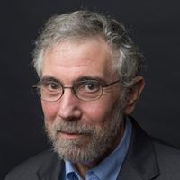
International Markets
Paul Krugman
1997 “In Praise of Cheap Labor”
Hiring cheap laborers in sweatshops in the Third World is a good thing for the laborers, not a bad thing

Slide 7
“In Praise of Cheap Labor”
“And yet, wherever the new export industries have grown, there has been measurable improvement in the lives of ordinary people”
“While fat-cat capitalists might benefit from globalization, the biggest beneficiaries are, yes, Third World workers”

Slide 8
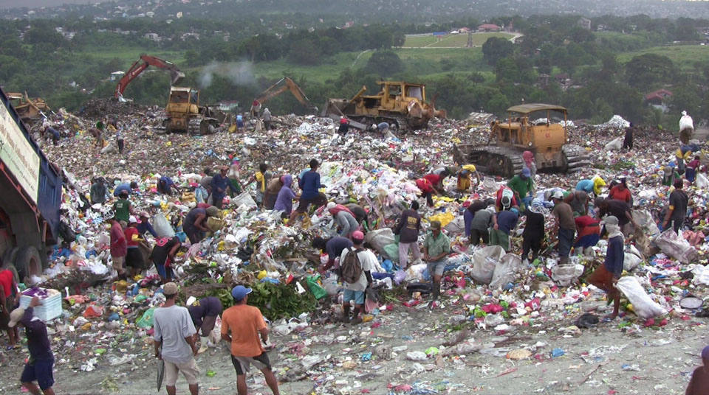
“In Praise of Cheap Labor”
“Smokey Mountain”

Slide 9
“In Praise of Cheap Labor”
“Smokey Mountain”
Several thousand people made a living by rummaging through garbage
A scavenger made about $10 per day by turning in recyclables

Slide 10
Choice

Slide 11
Choice
Matt Zwolinski

Slide 12
Choice
Matt Zwolinski
If people choose sweatshops, then it is wrong to interfere with that choice

